Slide 1


An Introduction for Compositional Generalization in NLP
Presenter：Li Zhaoyi
2022/6/7

Slide 2
Content
@0: A Brief Intro
@1: Concept of ‘Compositional Generalization’
---1.1 from linguistic perspective
---1.2 tasks & datasets
@2: Research on Compositional Generalization in NLP
---2.1 Specialized Architectures & Pretrained Models
---2.2 Optimization Algorithms
---2.3 Data Augmentation Methods
@3: Conclusion

Slide 3
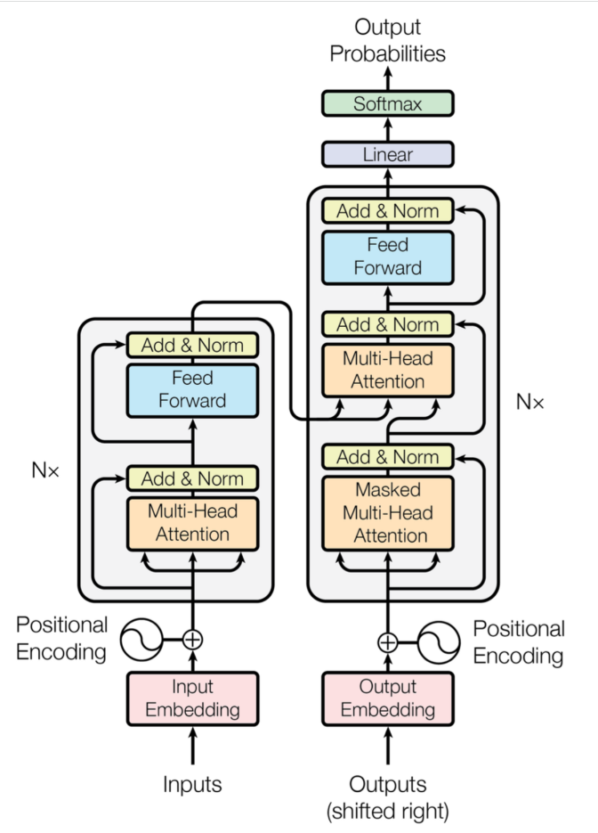
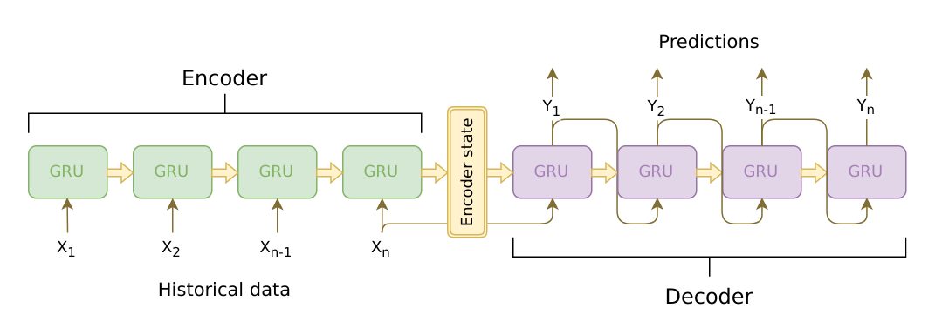
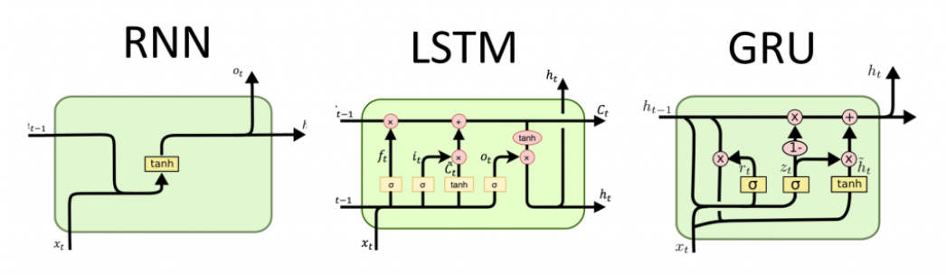


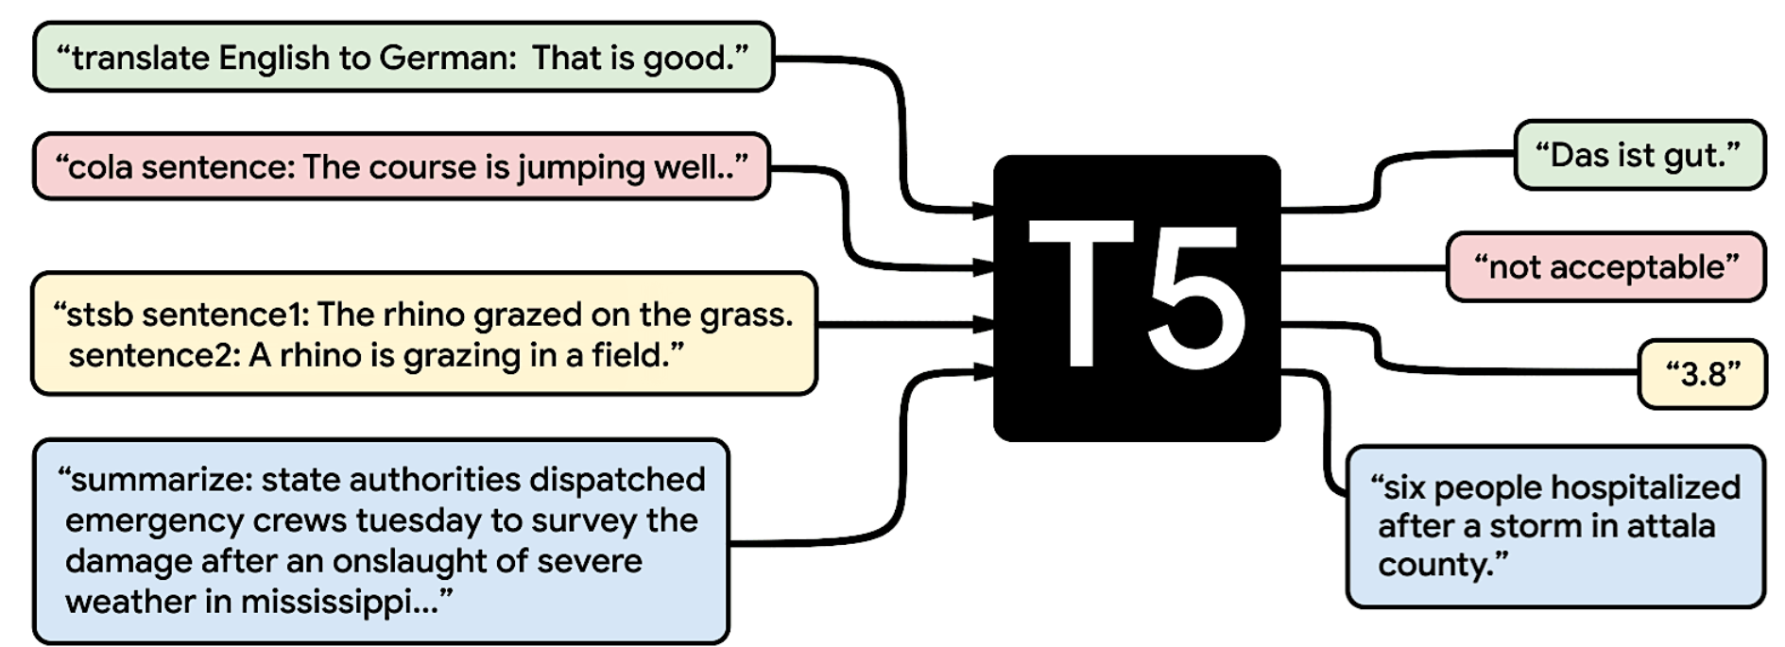
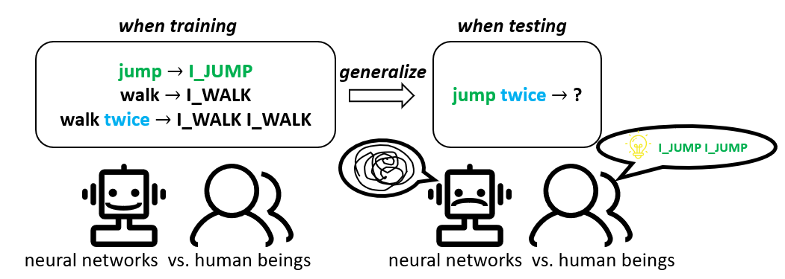
A Brief Intro
Backgrounds
RNNs(1990s,1997,2014)
RNN-based & Attention seq2seq(2014,Yoshua Benjio)
Transformer(2017,Google)
BERT(2018,Google)
GPTs(2018,2019,2021,OpenAI)
T5:text-to-text transfer transformer(2020,Google)
When testing the capacity for compositional generalization of tradition NLM on SCAN-task

Slide 4
A Brief Intro
Traditional neural language models have achieved impressive results in a variety of NLP tasks, but they perform disappointingly when we test for their compositional generalization capacity. In this slides we will mainly talk about this specific class of out-of-distribution problems in NLP, especially in Seq2Seq tasks, where training set and testing set are not identically distributed but their distributions are constrained by compositionality.
This report will focus on the following points:
the concept of ‘compositionality’ from linguistic perspective.
classic datasets & tasks where we can test the compositional generalization capacity of models.
methods and approaches on improving the compgen capacity of models from the perspectives of model architecture, optimization algorithm and data augmentation.
Reference paper here

Slide 5
Content
@0: A Brief Intro
@1: Concept of ‘Compositional Generalization’
---1.1 from linguistic perspective
---1.2 tasks & datasets
@2: Research on Compositional Generalization in NLP
---2.1 Specialized Architectures & Pretrained Models
---2.2 Optimization Algorithms
---2.3 Data Augmentation Methods
@3: Conclusion

Slide 6
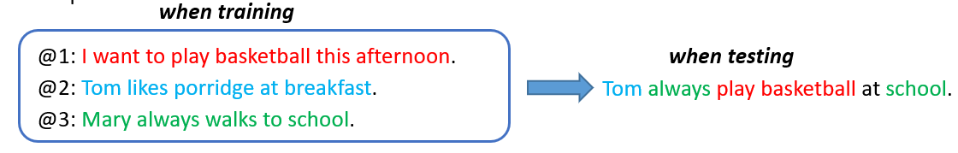
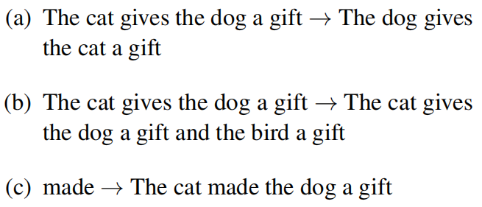
Compositionality
In semantics, mathematical logic and related disciplines, the principle of compositionality is the principle that the meaning of a complex expression is determined by the meanings of its constituent expressions and the rules used to combine them. This principle is also called Frege‘s principle, because Gottlob Frege is widely credited for the first modern formulation of it.—(wikipedia : principle of compositionality)
Human Language and thought are characterized by systematic compositionality, the algebraic capacity to understand and produce a potentially infinite number of novel combinations from known components.
Three key-components of compositional ability : systematicity, productivity and primitive application.
Systematicity allows for the use of known parts in novel combinations.
Productivity enables generalization to longer sequences than those seen before.
Primitive application allows for a word only seen in isolation before to be applied compositionally now.
Shakespeare is a poet. $→$ A is B. + A:Shakespeare ; B:a poet

Slide 7
Content
@0: A Brief Intro
@1: Concept of ‘Compositional Generalization’
---1.1 from linguistic perspective
---1.2 tasks & datasets
@2: Research on Compositional Generalization in NLP
---2.1 Specialized Architectures & Pretrained Models
---2.2 Optimization Algorithms
---2.3 Data Augmentation Methods
@3: Conclusion

Slide 8

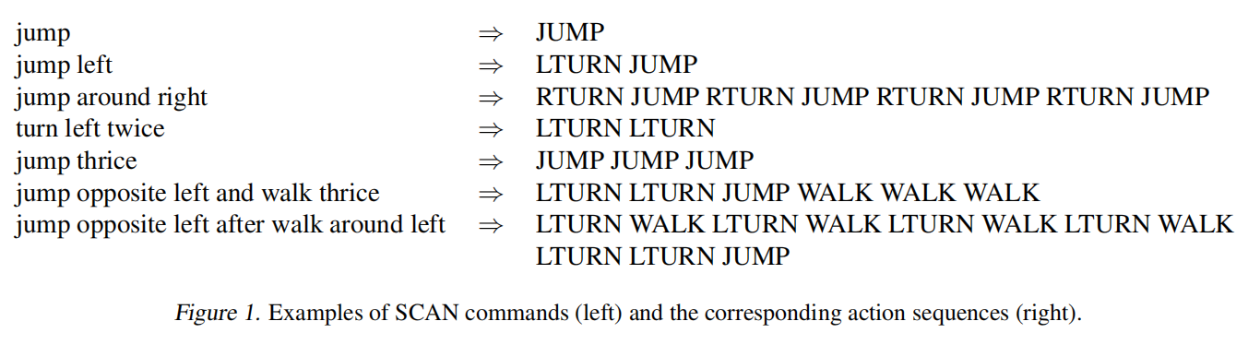

Tasks & Datasets
SCAN(ICML’18)
SCAN : Simplified version of the CommonAI Navigation tasks
Primitives: jump, look, walk, run
Adverbs: left, right, twice, thrice, opposite, around
Conjunctions: and, after
Auxiliary words: turn

Slide 9
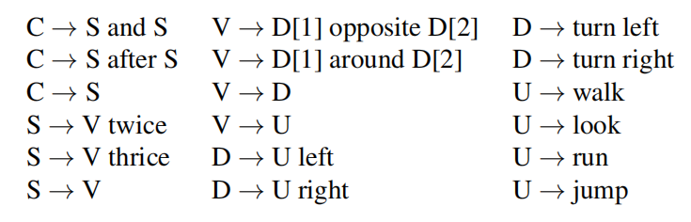
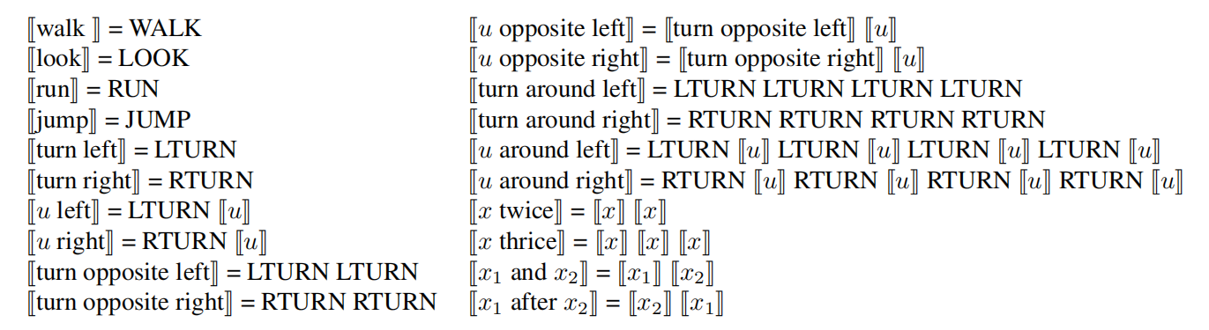
Tasks & Datasets
SCAN(ICML’18)
SCAN : Simplified version of the CommonAI Navigation tasks
Primitives: jump, look, walk, run
Adverbs: left, right, twice, thrice, opposite, around
Conjunctions: and, after
Auxiliary words: turn
Synthetic Grammar How to synthetic linguistic commands?
Interpretation functions
input linguistic commands
output action sequences

Slide 10
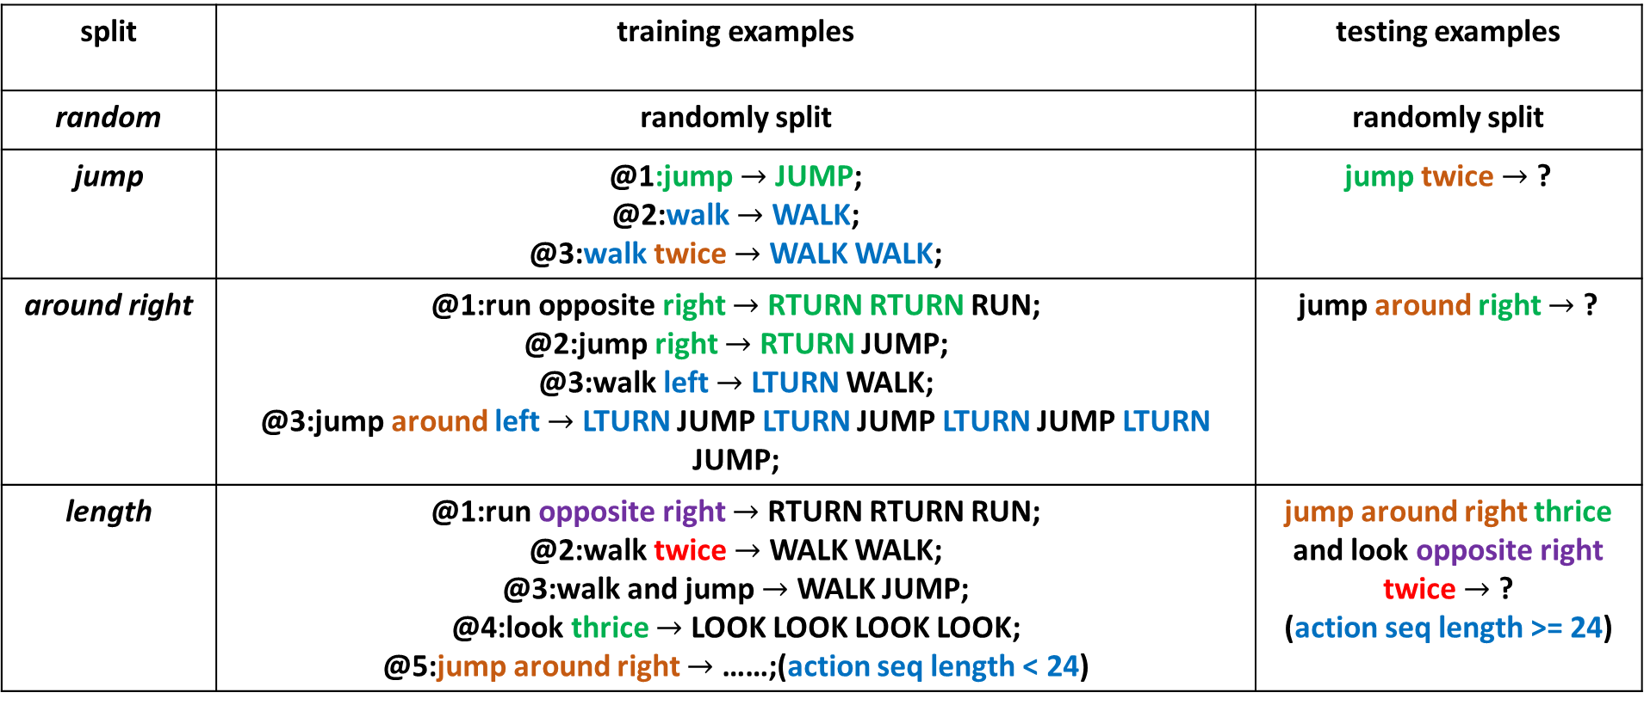
Tasks & Datasets
SCAN(ICML’18)
SCAN : Simplified version of the CommonAI Navigation tasks
split | training examples | testing examples
random | randomly split | randomly split
jump | @1:jump $→$ JUMP; @2:walk $→$ WALK; @3:walk twice $→$ WALK WALK; | jump twice $→$ ?
around right | @1:run opposite right $→$ RTURN RTURN RUN; @2:jump right $→$ RTURN JUMP; @3:walk left $→$ LTURN WALK; @3:jump around left $→$ LTURN JUMP LTURN JUMP LTURN JUMP LTURN JUMP; | jump around right $→$ ?
length | @1:run opposite right $→$ RTURN RTURN RUN; @2:walk twice $→$ WALK WALK; @3:walk and jump $→$ WALK JUMP; @4:look thrice $→$ LOOK LOOK LOOK LOOK; @5:jump around right $→$ ……;(action seq length < 24) | jump around right thrice and look opposite right twice $→$ ? (action seq length >= 24)
identical distribution
Prim Application
Systematicity
Productivity

Slide 11
Tasks & Datasets
SCAN(ICML’18)
SCAN : Simplified version of the CommonAI Navigation tasks
Evaluate Traditional Seq2Seq Neural Models on SCAN Tasks
SCAN | random | jump | around-right | length
LSTM | 99.9% | 0.1% | 2.5% | 13.8%
LSTM+A | 99.9% | 0.0% | 0.0% | 14.1%
Transformer | 100% | 1.0% | 53.3% | 0.0%
Evol. Trans. | 100% | 0.6% | 30.2% | 19.8%
Tips:
@1: these results are obtained from ‘Compositional Generalization in Semantic Parsing: Pre-training vs. Specialized Architectures ’(arxiv preprint’20).
@2: ‘Evol. Trans.’ = the Evolved Transformer(ICML’19)

Slide 12
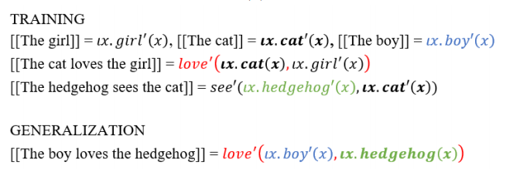
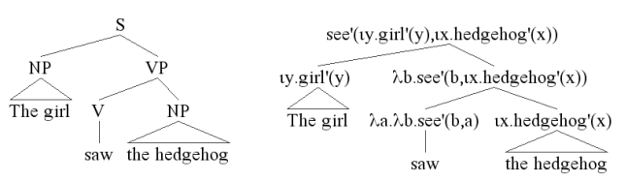
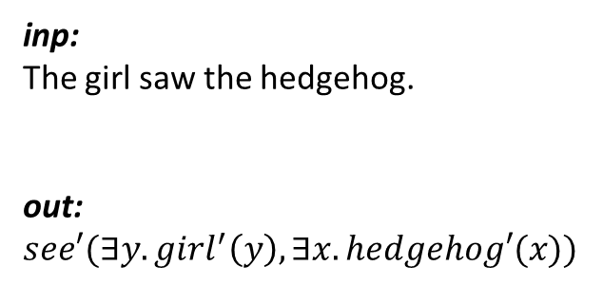
Tasks & Datasets
COGS(EMNLP’20)
COGS : a COmpositional Generalization challenge based on Semantic parsing
COGS-Semantic Parsing Task
inp:
The girl saw the hedgehog.
out: $see′(∃y.girl^{′}\left(y\right),∃x.hedgehog′(x))$
convert a natural language sentence to its logic-form
Frege’s Principle
The meaning of the whole sentence is compositionally built up from the meaning of its sub-parts, in accordance with the structure of its sub-parts.

Slide 13
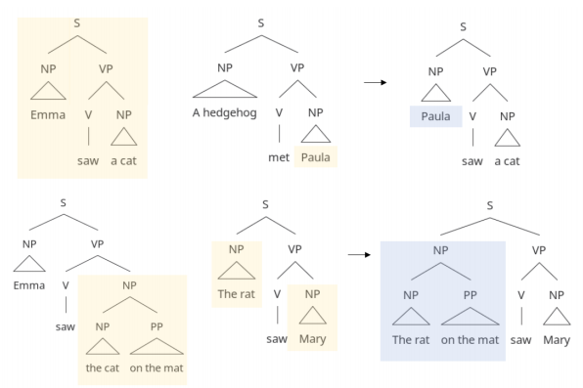







Tasks & Datasets
COGS(EMNLP’20)
COGS : a COmpositional Generalization challenge based on Semantic parsing
lexical generalization
structure generalization
generalization types in COGS

Slide 14
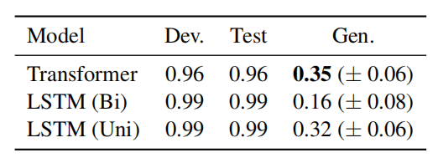
Tasks & Datasets
COGS(EMNLP’20)
COGS : a COmpositional Generalization challenge based on Semantic parsing
@1:novel combinations of familiar primitives and grammatical role.
Objective <-> Subjective : A hedgehog ate the cake. -> The baby liked the hedgehog.
Primitive -> Sub/Obj : Paula. -> The child helped Paula.
@2:novel combinations of modified phrases and grammatical role.
Obj <-> Sub : Noah ate the cake on the table. -> the cake on the table burned.
@3:deeper recursion.
PP modifiers : Ava saw the ball in the bottle on the table. -> Ava saw the ball in the bottle on the table on the floor.
@4:verb argument structure alternation.
Active <-> Passive : The crocodile blessed William. -> A muffin was blessed.
@5:verb class.
Theme NP <-> Unergative subject : The hippo decomposed. -> The hippo giggled.
evaluate seq2seq models on COGS task

Slide 15

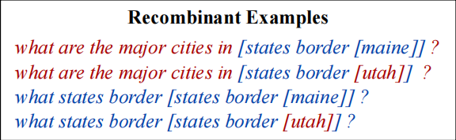
Tasks & Datasets
GeoQuery

Slide 16
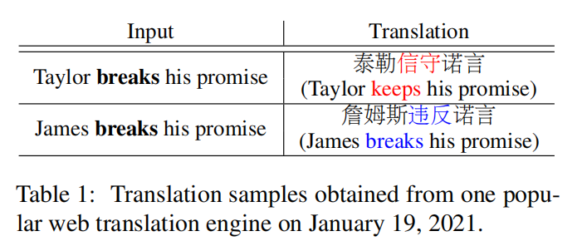
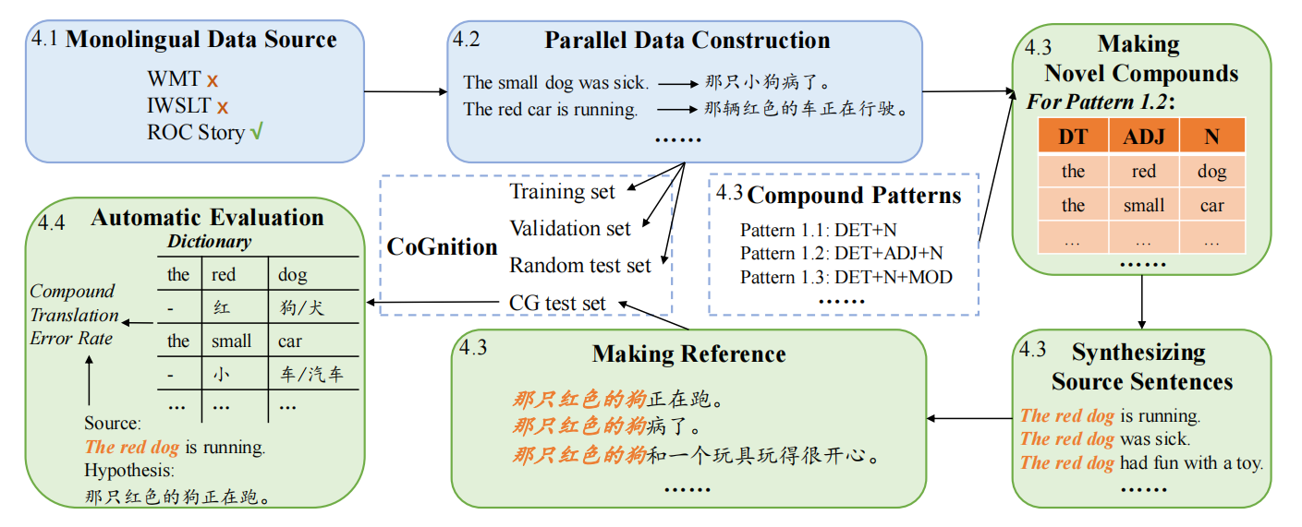
Tasks & Datasets
Cognition(ACL’21)
On Compositional Generalization of Neural Machine Translation(ACL’21, Main Conf.)

Slide 17
Content
@0: A Brief Intro
@1: Concept of ‘Compositional Generalization’
---1.1 from linguistic perspective
---1.2 tasks & datasets
@2: Research on Compositional Generalization in NLP
---2.1 Specialized Architectures & Pretrained Models
---2.2 Optimization Algorithms
---2.3 Data Augmentation Methods
@3: Conclusion

Slide 18
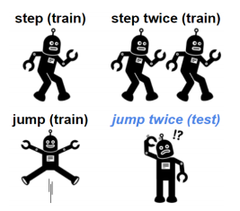
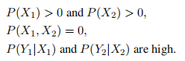
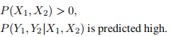
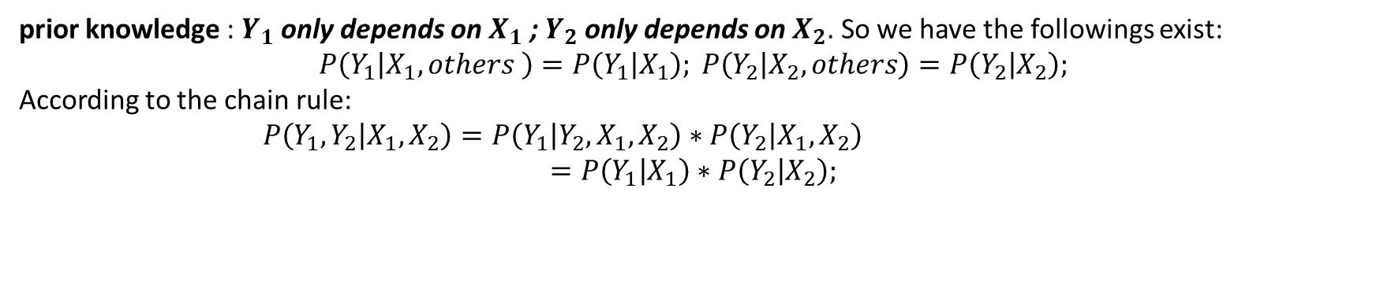
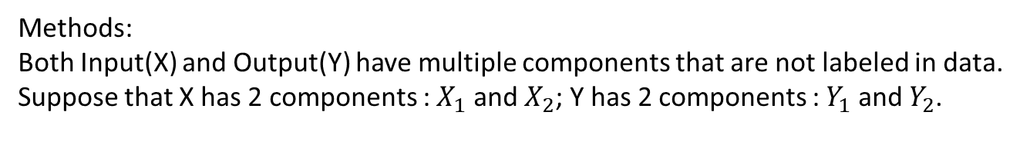
Specialized Archs
Primitive-Substitution(EMNLP’19,Main Conf)
Methods:
Both Input(X) and Output(Y) have multiple components that are not labeled in data.
Suppose that X has 2 components : $X_{1}$ and $X_{2}$; Y has 2 components : $Y_{1}$ and $Y_{2}$.
when training:
when testing:
compositionally generalize
we hope
prior knowledge : $Y_{1}$ only depends on $X_{1}$ ; $Y_{2}$ only depends on $X_{2}$. So we have the followings exist:
$$P\left(Y_{1} | X_{1}, others \right)=P\left(Y_{1} | X_{1}\right); P\left(Y_{2} | X_{2},others\right)=P\left(Y_{2} | X_{2}\right);$$
According to the chain rule:
$P\left(Y_{1},Y_{2} | X_{1},X_{2}\right)=P\left(Y_{1} | Y_{2},X_{1},X_{2}\right)∗P\left(Y_{2} | X_{1},X_{2}\right)$
$$=P\left(Y_{1} | X_{1}\right)∗P\left(Y_{2} | X_{2}\right);$$
high
high high

Slide 19
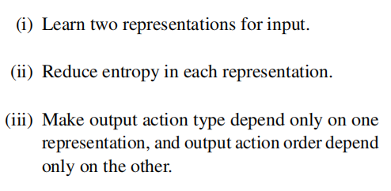
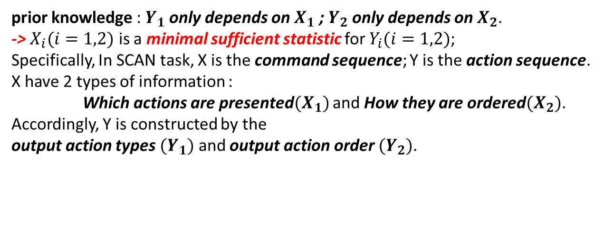
Specialized Archs
Primitive-Substitution(EMNLP’19,Main Conf)
prior knowledge : $Y_{1}$ only depends on $X_{1}$ ; $Y_{2}$ only depends on $X_{2}$.
-> $X_{i}(i=1,2)$ is a minimal sufficient statistic for $Y_{i}(i=1,2)$;
Specifically, In SCAN task, X is the command sequence; Y is the action sequence.
X have 2 types of information :
Which actions are presented$(X_{1})$ and How they are ordered$(X_{2})$.
Accordingly, Y is constructed by the
output action types $(Y_{1})$ and output action order $(Y_{2})$.
‘step’ and ‘jump’ contains the info about which action are presented;
‘twice’ contains the info about the order of them.
Goals

Slide 20
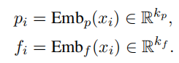
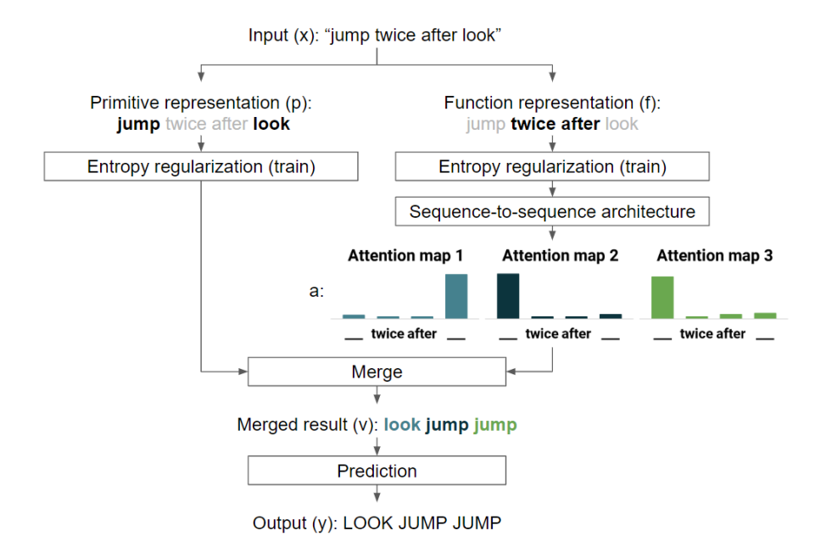
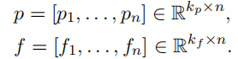
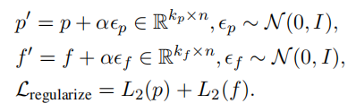

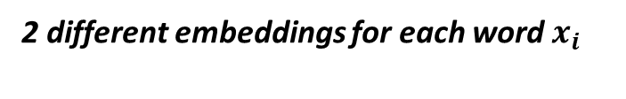
Specialized Archs
2 different embeddings for each word $x_{i}$
Primitive-Substitution(EMNLP’19,Main Conf)
concatenate$p_{i}$ and $f_{i}$
step-by-step decode
reduce info channel capacity by L2-norm;
and add some noise when training
weighted sum of attention map and primitive representations
one-layer fully-connected network to predict

Slide 21
Specialized Archs
Primitive-Substitution(EMNLP’19,Main Conf)
Model | rand | jump | around right | length
Baseline(best) | 99.9% | 0.1% | 2.5% | 14.1%
Proposed | 100% | 98.8% | 83.2% | 20.3%

Slide 22
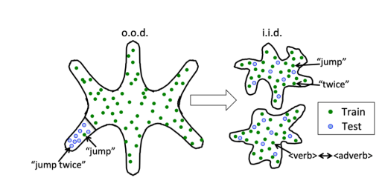
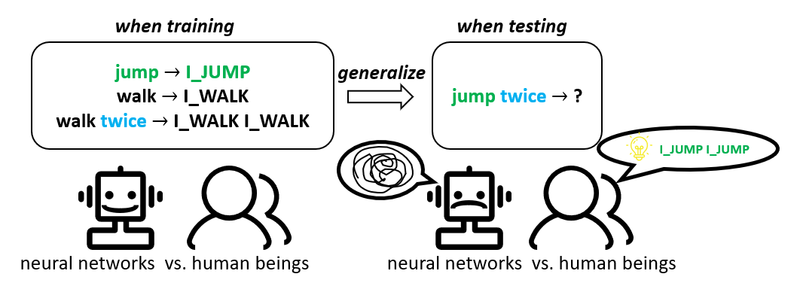
Specialized Archs
Syntactic-Attention(ACL’20,SRW)
Proposed Method:
separate syntactic info from semantic info
models trained on compgen tasks fail to generalize mainly because they have memorized biases that indeed exist in training set.
semantic
syntactic
walk twice
-> WALK WALK
Action twice
-> ACT ACT
transformation of an out-of-domain generalization problem into 2 independent, identically distributed problems
human capacity for systematic generalization is linked to mechanisms for processing syntax.
Compositional generalization by factorizing alignment and translation, ACL’20 SRW

Slide 23
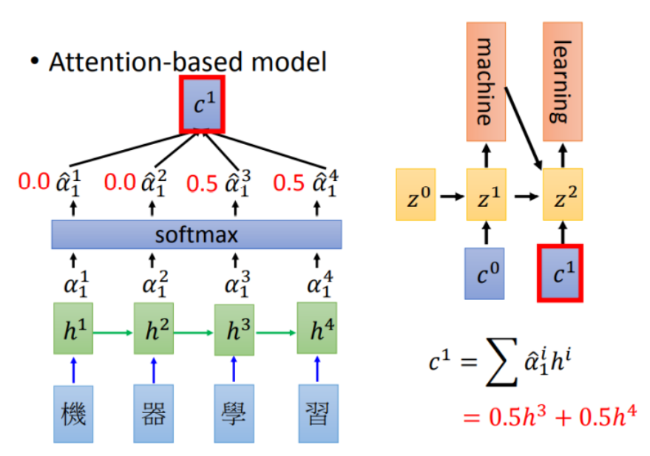
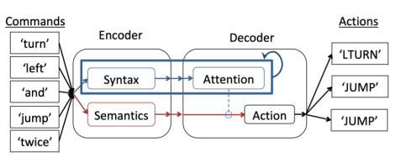
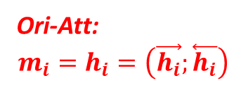
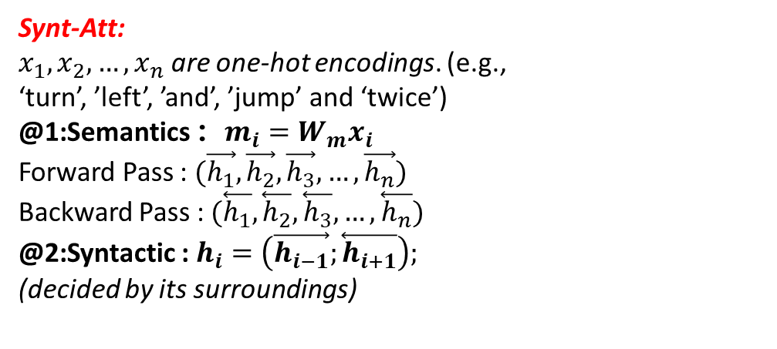
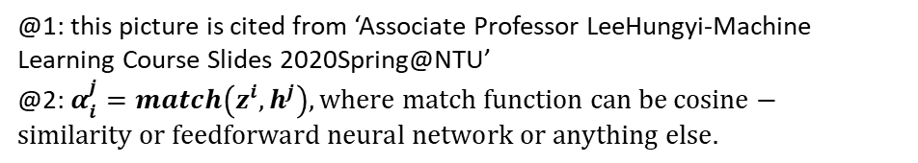
Specialized Archs
Syntactic-Attention(ACL’20,SRW)
decoder
Proposed Method : Syntactic Attention
Synt-Att:
$x_{1},x_{2},…,x_{n}$ are one-hot encodings. (e.g., ‘turn’, ’left’, ’and’, ’jump’ and ‘twice’)
@1:Semantics ：$m_{i}=W_{m}x_{i}$
Forward Pass : $(\vec{h_{1}},\vec{h_{2}},\vec{h_{3}},…,\vec{h_{n}})$
Backward Pass : $(\overset{⃖}{h_{1}},\overset{⃖}{h_{2}},\overset{⃖}{h_{3}},…,\overset{⃖}{h_{n}})$
@2:Syntactic : $h_{i}=\left(\vec{h_{i−1}};\overset{⃖}{h_{i+1}}\right);$
(decided by its surroundings)
encoder
Ori-Att:
$$m_{i}=h_{i}=\left(\vec{h_{i}};\overset{⃖}{h_{i}}\right)$$
@1: this picture is cited from ‘Associate Professor LeeHungyi-Machine Learning Course Slides 2020Spring@NTU’
@2: $α_{i}^{j}=match\left(z^{i}, h^{j}\right), where match function can be cosine−similarity or feedforward neural network or anything else.$

Slide 24
Specialized Archs
Syntactic-Attention(ACL’20,SRW)
Model | rand | jump | around right | length
LSTM-encoder-decoder | 99.9% | 0.1% | 2.5% | 14.1%
Primitive-Substitution(EMNLP’19) | 100% | 98.8% | 83.2% | 20.3%
Synt-Att(ACL’20,SRW) | 100% | 91.0% | None | 15.2%

Slide 25
Specialized Archs
Lexicon-Translation(ACL’21,Oral)
Review for the past two works
Lexicon-Translation
sequences
Primitive Substitution
Syntactic Attention
Disentangle Semantic info from Syntactic info;
Or Disentangle Syntactic info from Semantic info?
Lexicon
Syntactic
sequences
Proposed Method:
augment neural decoder with a lexical-translation mechanism based on existing copy-mechanisms
Semantic
Syntactic
Lexicon Learning for Few-Shot Neural Sequence Modeling(ACL’21,Oral)

Slide 26

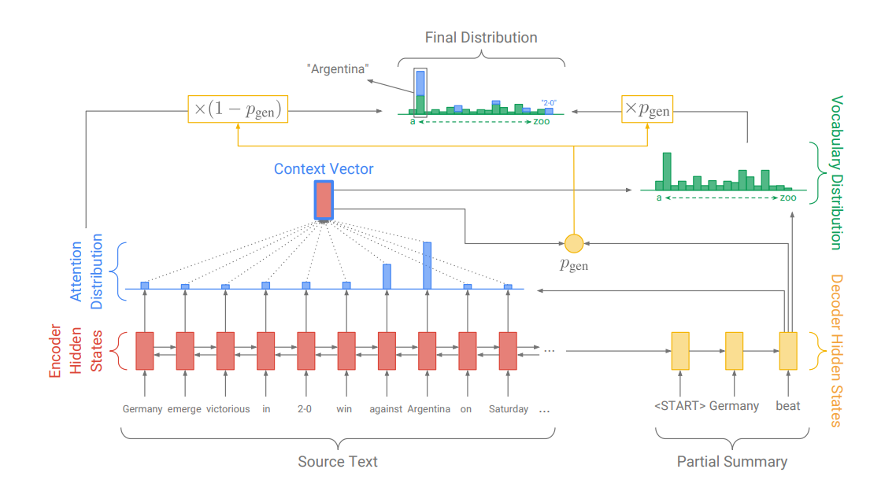
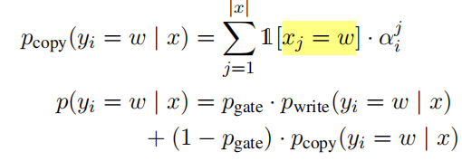
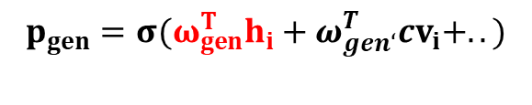
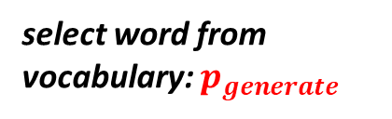

Specialized Archs
Joey is in the Vocabulary.
Lexicon-Translation(ACL’21,Oral)
Out-Of-Vocabulary Word
Hello, my name is Joey.
Copy-Mechanism
Get to the point: Summarization with pointer
generator networks(ACL’17,Cited by 2200+ times up to now)
Hi, Joey.
select word from vocabulary: $p_{generate}$
copy from input: $p_{copy}$
Li Zhaoyi is Out-Of-Vocabulary Words.
Hello, my name is Li Zhaoyi.
$$p_{gen}=σ(ω_{gen}^{T}h_{i}+ω_{gen‘}^{T}cv_{i}+..)$$
Hi, Joey.
learnable parameters

Slide 27
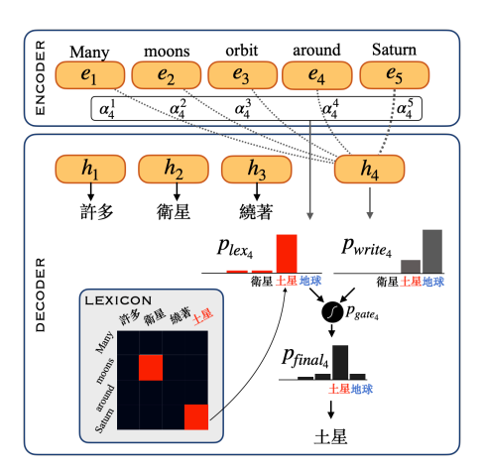
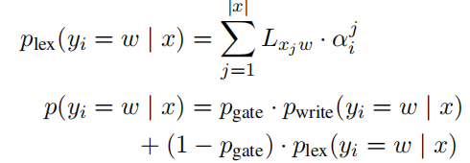
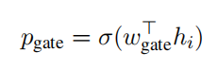

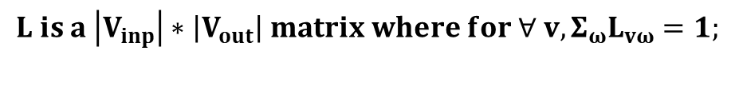
Specialized Archs
Lexicon-Translation(ACL’21,Oral)
$$L is a \left|V_{inp}\right|∗\left|V_{out}\right| matrix where for ∀ v, Σ_{ω}L_{vω}=1;$$
We hope that $L_{Saturn,土星}$and $a_{土星}^{Saturn}$ are high at the same time.
$$p_{lex}\left(y_{i}=土星 | x\right)=0.1∗att\left(Many\right)+0.1∗att\left(moons\right)+..+0.7∗att(Saturn)$$
similar with copy-mechanism
0.1
0.1
0.1
0.7
learnable parameters

Slide 28
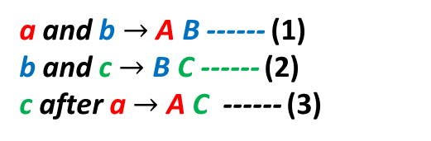
Specialized Archs
Lexicon-Translation(ACL’21,Oral)
Methods | Jump(SCAN) | A-right(SCAN) | COGS
LSTM(enc-dec) | 0.1% | 2.5% | 51%
Prim-Sub | 98.8% | 83.2% | None
SyntAtt | 91.0% | None | None
Lex-Trans | 92% | 95% | 82%
How to initialize L?
Previous Works:
@1: Statistical Alignment
@2: Mutual Information
@3: Bayesian Lexicon Learning
Proposed Simple Alignment Method(strict version)
a and b $→$ A B ------ (1)
b and c $→$ B C ------ (2)
c after a $→$ A C ------ (3)
a | A
b | B
c | C
Methods | COGS
Lex-Trans(Fix L) | 82%
Lex-Trans(Fine-Tune L) | 83%
Tips: there are some relax-operations.
Details please find in the original paper.

Slide 29
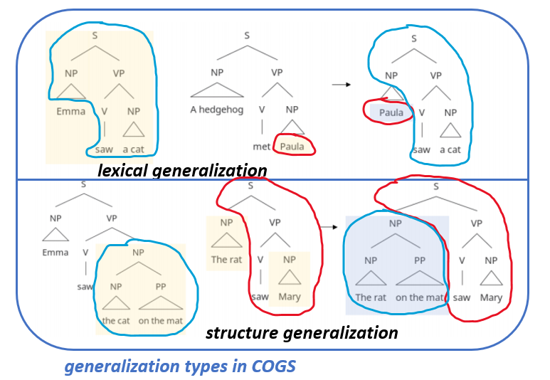
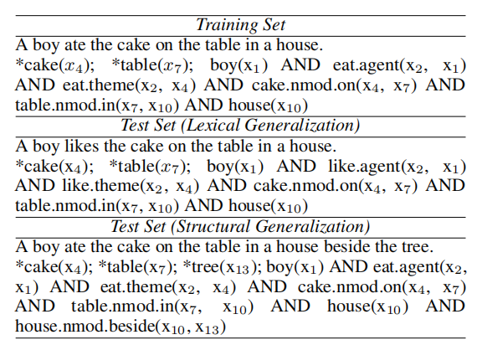
Specialized Archs
Disentangled-Seq2Seq(ACL’22, Main conf)
new composition of familiar relations:
We hope that the PP ‘beside the tree’
and the modified noun ‘house’ have no spurious correlations.
Disentangled Sequence to Sequence Learning for Compositional Generalization(ACL’22)

Slide 30
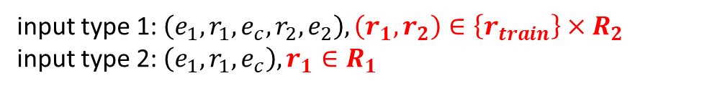






Specialized Archs
Disentangled-Seq2Seq(ACL’22, Main conf)
Toy-experiment:
$x=(e_{1},r_{1},e_{c},r_{2},e_{2})$ is an input sequence of symbols. Our goal is to predict the relation $y_{1}$ and $y_{2}$.
relation symbol, $r_{1}∈R_{1},r_{2}∈R_{2}$(denote different relations)
entity symbol, to simplify this problem, we set them to the same symbol e. $(e_{i}\left(i=1,2,3\right)∈\left\{e\right\})$
relation,$y_{1}∈L_{1},y_{2}∈L_{2}$
one-to-one mapping between $R_{1}$ and $L_{1}$; $R_{2}$ and $L_{2}$.
$$\left|R_{1}\right|=\left|R_{2}\right|=10$$
when training
input type 1: $\left(e_{1},r_{1},e_{c},r_{2},e_{2}\right), \left(r_{1},r_{2}\right)∈\left\{r_{train}\right\}×R_{2}$
input type 2: $\left(e_{1},r_{1},e_{c}\right),r_{1}∈R_{1}$
when testing
test input : $\left(e_{1},r_{1},e_{c},r_{2},e_{2}\right), \left(r_{1},r_{2}\right)∈R_{1}×R_{2}$

Slide 31






Specialized Archs
Disentangled-Seq2Seq(ACL’22, Main conf)
when training
Encoder:
$$\left(e_{1},r_{1},e_{c},r_{2},e_{2}\right)→\left(h_{1},h_{2},h_{3},h_{4},h_{5}\right);$$
$\left(e_{1},r_{1},e_{c}\right)→\left(h_{1}^{′},h_{2}^{′},h_{3}^{′}\right);$
input type 1: $\left(e_{1},r_{1},e_{c},r_{2},e_{2}\right), \left(r_{1},r_{2}\right)∈\left\{r_{train}\right\}×R_{2}$
input type 2: $\left(e_{1},r_{1},e_{c}\right),r_{1}∈R_{1}$
when testing
test input : $\left(e_{1},r_{1},e_{c},r_{2},e_{2}\right), \left(r_{1},r_{2}\right)∈R_{1}×R_{2}$
ignoring
2 training methods:
@1: joint training: use concatenated encoding ($\left(h_{1};h_{3}\right)$; or $\left(h_{1}^{′};h_{3}^{′}\right)$) to predict $y_{1}$; use $(h_{3};h_{5})$ to predict $y_{2}$;
@2: separate training: only use encoding $(h_{3};h_{5})$ to train our model only to predict $y_{2}$;
Training | Acc of predicting y_2
Separate-train | 100%
Joint-train | 55%
in our toy experiments, $r_{1}$ has huge impact on the prediction of $r_{2}$.

Slide 32




Specialized Archs
Disentangled-Seq2Seq(ACL’22, Main conf)
A simple Solution
contextual encoding
decoder
encoder
predict $y_{1}$; predict $y_{2}$
$$\left(e_{1},r_{1},e_{c},r_{2},e_{2}\right)$$
indicator
Training | Acc of predicting y_2
Separate-train | 100%
Joint-train | 55%
Joint-train w. indicator | 97%
e.g. :(1,1,1,0,0); (0,0,1,1,1)
when predicting $y_{1};$
when predicting $y_{2};$
lesson:
we want the encoder to ‘attend’ more on one specific ‘relation’ when our model predicting it so that this process would not be impacted by other relations in the input sequence.

Slide 33






Specialized Archs
Disentangled-Seq2Seq(ACL’22, Main conf)
At time-step t:
$(y_{1},y_{2},…,y_{t−1})$
$$y_{t}$$
$$(h_{t,1},h_{t,2},h_{t,3},…,h_{t,n},h_{t,n+1},…,h_{t,n+t−1})$$
decoder
Traditional seq2seq
encoder-decoder
encoder
Phase1: encode
Phase2: decode step by step
$$\left(x_{1},x_{2},x_{3},…,x_{n}\right)$$
$(y_{1},y_{2},…,y_{t−1})$
Adaptatively re-encoding the source input at every step of decoding
shortcomings: the fixed input encoding are used to predict all the target symbols, and are therefore expected to capture all possible relations in the input.
$$C_{t}=(x_{1},x_{2},…,x_{n},y_{1},y_{2},…,y_{t−1})$$
$$H_{t}=f_{encoder}\left(C_{t}\right)=(h_{t,1},h_{t,2},h_{t,3},…,h_{t,n},h_{t,n+1},…,h_{t,n+t−1})$$
$$S_{t}=H_{t}[:n]$$
$$p\left(y_{t} | {x,y}_{<t}\right)=f_{decoder}(S_{t};y_{<t})$$
re-encoding
the model tends to zero in on information relevant for the current prediction and remains invariant to irrelevant information, thereby improving disentanglement.

Slide 34

Specialized Archs
recursion depth = 1
Tom want to eat the cake in the bucket on the table in the house beside the tree in the yard.
Disentangled-Seq2Seq(ACL’22, Main conf)

Slide 35
Content
@0: A Brief Intro
@1: Concept of ‘Compositional Generalization’
---1.1 from linguistic perspective
---1.2 tasks & datasets
@2: Research on Compositional Generalization in NLP
---2.1 Specialized Architectures & Pretrained Models
---2.2 Optimization Algorithms
---2.3 Data Augmentation Methods
@3: Conclusion

Slide 36

Pretrained Models
NQG-T5(ACL’21)
different expressions with similar meaning; various sentence structures;
Compositional Generalization vs. Natural Language Variation
Synthetic Tasks(e.g., SCAN)
require introducing strong compositional inductive bias to our models.
Non-synthetic Tasks(e.g., GeoQuery)
Similar Source : which state in the USA has the highest place?
require model to have better capacity to process natural language variation.
Compositional Generalization and Natural Language Variation: Can a Semantic Parsing Approach Handle Both?(ACL’21)

Slide 37

Pretrained Models
NQG-T5(ACL’21)
How to combine strong compositional inductive bias and powerful general-purpose pretrained models?
Proposed Method: NQG-T5
NQG consists of a discriminative Neural semantic parsing model and a Quasi-synchronous Grammar induction algorithm.
T5 is Text-To-Text Transfer Transformer, a very powerful general-purpose seq2seq pretrained model proposed by Google Research @ 2020.
T5 can easily handle natural language variations.
NQG-part, NQG can precisely handle those sentences/task-inputs are highly structured and introduce comp-inductive bias.

Slide 38


Pretrained Models
NQG-T5
NQG details (more info please find in the original paper’ Compositional Generalization and Natural Language Variation: Can a Semantic Parsing Approach Handle Both?’)
Part1: Q-CFG(context free grammar)-induction
Intuition : smallest and simplest grammar that explains the data well.
Formalize : Minimum Description Length Principle
Search Strategy : Greedy Search
Part2: Neural Semantic Parsing Model
Apply the Grammar extracted by QCFG-algo to input natural language commands.
@1: if the parser can not use the grammar to parse the input sentence -> RUN T5 !
@2: else,
(e.g. input sentence now is ‘walk after jump thrice’)
option 1: <walk> after <jump thrice>
option 2: <walk after jump> thrice
we use a neural network to score these 2 options.

Slide 39


Pretrained Models
NQG-T5
Synthetic Task
Non-synthetic Task

Slide 40
Content
@0: A Brief Intro
@1: Concept of ‘Compositional Generalization’
---1.1 from linguistic perspective
---1.2 tasks & datasets
@2: Research on Compositional Generalization in NLP
---2.1 Specialized Architectures & Pretrained Models
---2.2 Optimization Algorithms
---2.3 Data Augmentation Methods
@3: Conclusion

Slide 41
Optimization Algos
the most classic optimization-based meta-learning algo
CG-MAML(ACL’21,Main Conf)
compositionally generalize
Related Works
MAML (ICML’17) Model-Agnostic Meta-Learning for Fast Adaptation of Deep Networks
DG-MAML (AAAI’18) Learning to Generalize : Meta-Learning for Domain Generalization
CG-MAML (ACL’21) Meta-Learning to Compositionally Generalize
Meta Learning to Compositionally Generalize (ACL’21)

Slide 42


Optimization Algos
MAML(ICML’17)
@1: these pictures is cited from ‘Associate Professor LeeHungyi-Machine Learning Course Slides 2020Spring@NTU’
Model-Agnostic Meta-Learning for Fast Adaptation of Deep Networks(ICML’17)

Slide 43


Optimization Algos
MAML(ICML’17)
@1: these pictures is cited from ‘Associate Professor LeeHungyi-Machine Learning Course Slides 2020Spring@NTU’
Model-Agnostic Meta-Learning for Fast Adaptation of Deep Networks(ICML’17)

Slide 44














Optimization Algos
“meta-training”
没有真正地改变模型参数！
CG-MAML(ACL’21,Main Conf)
$$θ_{i}^{′}=θ_{0}−α∇_{θ}loss_{train−i} (θ_{0})$$
$$loss_{test−n}(θ_{n}′)$$
MAML :
taskn
task1
$$loss_{test…}(θ_{i}′)$$
task…
task1
neural network
$$loss_{test−2}(θ_{2}′)$$
$$\min_{θ_{0}}{(Σ_{i=1}^{n}loss_{test−i}(θ_{i}′))}$$
Initialization $θ_{0}$
task2
task1
$$loss_{test−1}(θ_{1}′)$$
new task
fine-tune
$$θ=θ −∇_{θ}(L_{newtask}(θ))$$
$θ_{0}=φ$,
“meta-testing”
fast adaptation of deep networks
CG-MAML :
$$θ^{′}=θ−α∇_{θ}loss_{train′} (θ)$$
virtual task
neural network
Initialization $θ_{0}$
Train’
Test’
$$L\left(θ\right)=loss_{train^{′}}\left(θ\right)+loss_{test^{′}}(θ′)$$
sample compositional inductive-bias
Update:$θ=θ−β∇_{θ}L(θ)$
Training set
“meta-training+meta-testing”
Meta Learning to Compositionally Generalize (ACL’21)

Slide 45



Optimization Algos
CG-MAML(ACL’21,Main Conf)
details in creating virtual tasks
$$p_{sample}\left(x^{′},y^{′} | x,y\right)∝exp⁡(sim\left(\left[x^{′},y^{′}\right],\left[x,y\right]\right)∗α)$$
@1:$\left[x,y\right]:training data in virtual tasks;$
@2:$\left[x^{′},y^{′}\right]:testing data in virtual tasks;$
@3:$α is a hyper−parameter :temperature that controls the sharpness of distribution;$
@4:‘sim’ is the similarity function :
---Tree Kernel
---String Kernel
---Lev Distance
compositional inductive-bias
similar atoms but novel combinations
Meta Learning to Compositionally Generalize (ACL’21)

Slide 46

Optimization Algos
CG-MAML(ACL’21,Main Conf)
Meta Learning to Compositionally Generalize (ACL’21)

Slide 47
Content
@0: A Brief Intro
@1: Concept of ‘Compositional Generalization’
---1.1 from linguistic perspective
---1.2 tasks & datasets
@2: Research on Compositional Generalization in NLP
---2.1 Specialized Architectures & Pretrained Models
---2.2 Optimization Algorithms
---2.3 Data Augmentation Methods
@3: Conclusion

Slide 48


Data Augmentation
Good Enough Compositionally Data Augmentation (ACL’20)
GECA(ACL’20, Main Conf.)
Proposed Method:
formally state:
If there are these 3 training data in the original training set:
$$x_{1}=temp_{1}+frag_{1};$$
$$x_{2}=temp_{2}+frag_{2};$$
$$x_{3}=temp_{3}+frag_{1};$$
and $temp_{1},temp_{2}$ satisfy:
$$env\left(x_{1},temp_{1}\right)=env\left(x_{2},temp2\right);$$
then we can augment:
$$x_{aug}=temp_{3}+frag_{2}$$
augmented data
template@3: Pat..cats.. .
Fragment@1: ..picks..up..
Fragment@2: ..puts..down..
Environment@1: She..the wug..in
Fragment@1 ~ Fragment@2
template@1: She..the wug..in Fresno.
template@2: She..the wug.. In Tempe.

Slide 49





Data Augmentation
GECA(ACL’20, Main Conf.)
How to seq2seq data?
How to seq2seq data?
I sing. $Δ$ Canto.
I sing marvelously. $Δ$ Canto maravillosamente.
I dax marvelously. $Δ$ Dajo maravillosamente.
$Δ$ $≈$ <PAD> marvelously $Δ$ <PAD> maravillosamente
_:env@1; _:frag@1; _:frag@2;
augment
I dax. $Δ$ Dajo.
I dax. $Δ$ Dajo.
augmented training data
original training data
Pros: introduce compositionally inductive-bias; the quality of data is ‘good’.
Cons: high computational overhead. Time Complexity of GECA is $O(ft^{2}e)$.
Good Enough Compositionally Data Augmentation (ACL’20)

Slide 50

Data Augmentation
GECA(ACL’20, Main Conf.)
Good Enough Compositionally Data Augmentation (ACL’20)

Slide 51




Data Augmentation
Sequence-Level Mixed Sample Data Augmentation(EMNLP’20)
SeqMix(EMNLP’20, Main Conf. short paper)
recombination
Hard-version SeqMix
Pros:
1:introducing strong compositional inductive-bias.
2:online-augment, fast
Cons:
Most of augmented data is incorrect. These noisy seq2seq data will bring negative influence on model training.

Slide 52



Data Augmentation
SeqMix(EMNLP’20, Main Conf. short paper)
relax ：Hard-version -> Soft-version
Hard-version SeqMix
$$\left(\hat{X},\hat{Y}\right)=(m_{X}⨀X_{1}+(1−m_{X})⨀X_{2},m_{Y}⨀Y_{1}+(1−m_{Y})⨀Y_{2})$$
*: $′⨀′$ is element-wise product.
RELAX
Soft-version SeqMix
$$\left(E[\hat{X}],E[\hat{Y}]\right)=({E[m}_{X}⨀X_{1}+(1−m_{X})⨀X_{2}],E[m_{Y}⨀Y_{1}+(1−m_{Y})⨀Y_{2}])$$
$$=(λX_{1}+\left(1−λ\right)X_{2},λY_{1}+\left(1−λ\right)Y_{2})$$
Sequence-Level Mixed Sample Data Augmentation(EMNLP’20)

Slide 53

Data Augmentation
SeqMix(EMNLP’20, Main Conf. short paper)
Sequence-Level Mixed Sample Data Augmentation(EMNLP’20)

Slide 54
Content
@0: A Brief Intro
@1: Concept of ‘Compositional Generalization’
---1.1 from linguistic perspective
---1.2 tasks & datasets
@2: Research on Compositional Generalization in NLP
---2.1 Specialized Architectures & Pretrained Models
---2.2 Optimization Algorithms
---2.3 Data Augmentation Methods
@3: Conclusion

Slide 55
Conclusion
improve the capacity of compositional generalization
introducing compositional inductive-bias for models
Design Specific Archs
Make good use of Pretrained Models
Optimization Algos
Data Augmentation
Pretrained Models:
Ads: handling natural language variations.
Disads: poor in compositionally generalizing.
Open Problem: How to better introduce comp-inductive-bias for pretrained models?
Meta-Learning:
the construction of virtual tasks
Model-Agnostic
@1: Various Data Recombination
@2: Less Noisy Augmented Data
(Seq2Seq data)
@3: Time Complexity
@4: Directed Augment
Disentangle:
Semantic & Syntactic

Slide 56
References & Road-Map
Datasets
Brenden Lake, Marco Baroni, Generalization without Systematicity: On the Compositional Skills of Sequence-to-Sequence Recurrent Networks, ICML’18
Najoung Kim, Tal Linzen, COGS: A Compositional Generalization Challenge Based on Semantic Interpretation, EMNLP’20
Yafu Li, Yongjing Yin, Yulong Chen, Yue Zhang, On Compositional Generalization of Neural Machine Translation, ACL’21
Specialized Archs
Yuanpeng Li, Liang Zhao, Jianyu Wang, Joel Hestness, Compositional Generalization for Primitive Substitutions, EMNLP’19
Jacob Russin, Jason Jo, Randall C. O’Reilly, Yoshua Bengio, Compositional generalization by factorizing alignment and translation, ACL’20
Ekin Akyürek, Jacob Andreas, Lexicon Learning for Few-Shot Neural Sequence Modeling, ACL’21
Hao Zheng, Mirella Lapata, Disentangled Sequence to Sequence Learning for Compositional Generalization , ACL’22
Pretrained Models
Daniel Furrer, Marc van Zee, Nathan Scales, Nathanael Schärli, Compositional Generalization in Semantic Parsing: Pre-training vs. Specialized Architectures, Arxiv’20
Peter Shaw, Ming-Wei Chang, Panupong Pasupat, Kristina Toutanova, Compositional Generalization and Natural Language Variation: Can a Semantic Parsing Approach Handle Both?, ACL’21
Algos
Da Li, Yongxin Yang, Yi-Zhe Song, Timothy M. Hospedales, Learning to Generalize: Meta-Learning for Domain Generalization, AAAI’18
Henry Conklin, Bailin wang, Kenny Smith, Ivan Titov, Meta-Learning to Compositionally Generalize, ACL’21
Data Augmentations
Jacob Andreas, Good-Enough Compositional Data Augmentation, ACL’20
Demi Guo, Yoon Kim, Alexander M. Rush, Sequence-Level Mixed Sample Data Augmentation, EMNLP’20

Slide 57
References & Road-Map
For more paper(related to Compgen):
https://github.com/Joeyleerio/Weekly-Meeting/blob/master/papers(week9)/paper_list.md
For Road-Map:
https://github.com/FranxYao/Compositional-Generalization-in-Natural-Language-Processing
THANKS FOR YOUR LISTENING!

